Slide 1
Dominant Narratives Counter-Narratives Resistance Narratives
Notes:
Greeting– Daren
Reading– Scott
Debrief–Daren
Thanksgiving– Scott
Civil Rights figures– Daren

Slide 2
Agenda
Greeting
Reading
Initiative

Slide 3
Agenda
Greeting
Reading
Initiative

Slide 4
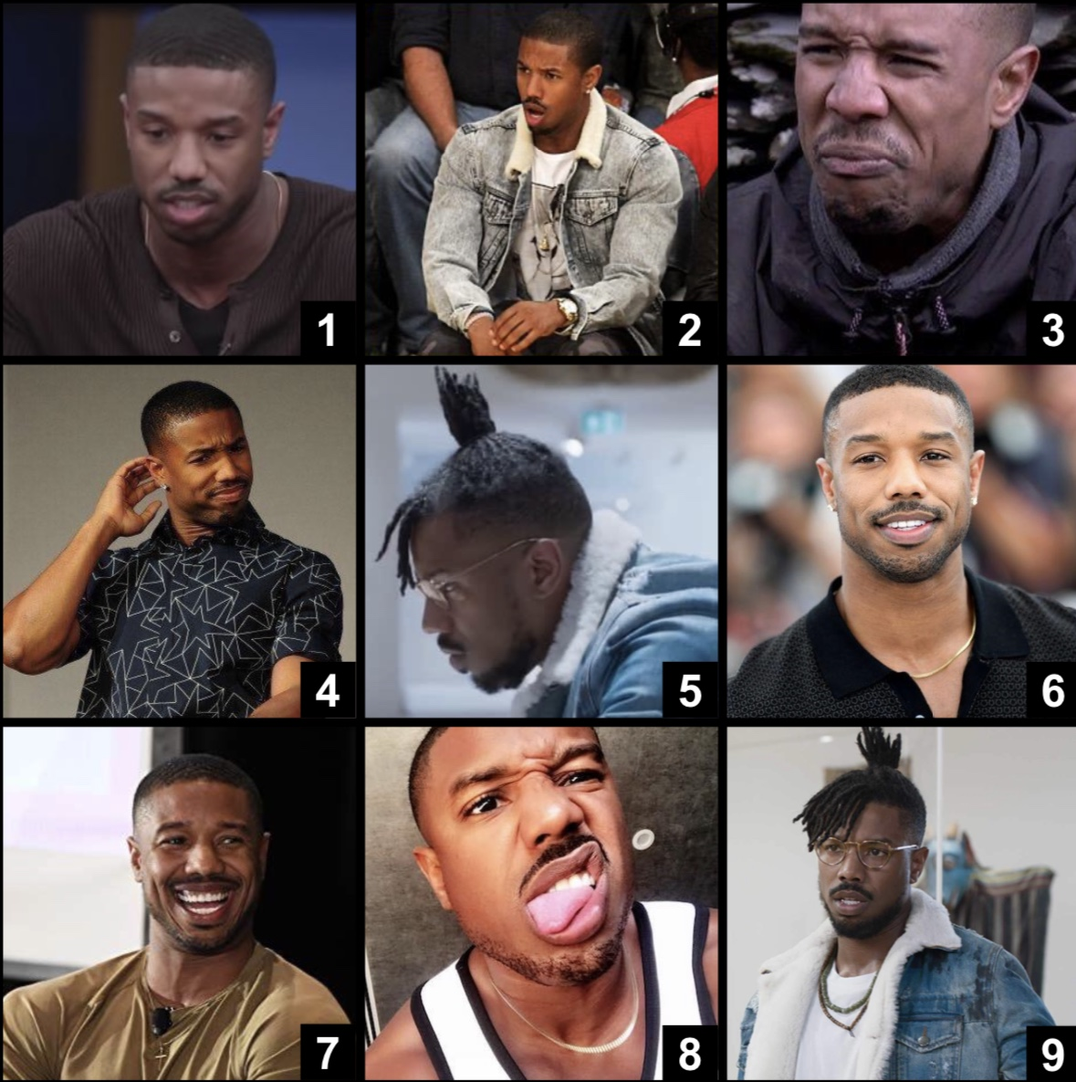
Greeting
Which Michael B. Jordan are you today?

Slide 5
Agenda
Greeting
Reading
Initiative

Slide 6
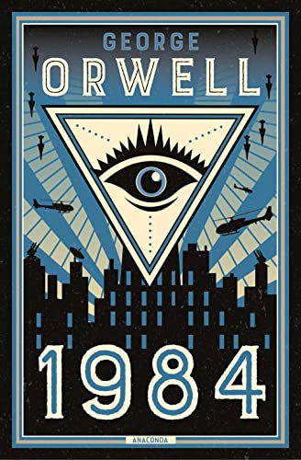
Reading
“Who controls the past controls the future, and who controls the present controls the past.”
–George Orwell, 1984
What does this get you thinking about?

Slide 7
Agenda
Greeting
Reading
Initiative
Notes:
“You were worried students weren’t aware of the dominant narratives…”

Slide 8
Stories about Justice & Injustice
Dominant Narratives
Counter-Narratives
Resistance Narratives
Notes:
Adapted from Lee Anne Bell’s Storytelling for Social Justice
Dominant narratives are well-known, taken-for-granted stories that seek to justify the status quo, paper over the effects of injustice, or diminish the efforts of those trying to challenge injustice.
Counter narratives are the stories hidden beneath the dominant narratives that offer important truths about how issues of justice and injustice have shaped life in the United States.
Counter narratives can become resistance narratives when they inspire, motivate, and inform the efforts of future generations of citizens and activists to challenge injustice

Slide 9
Stories about Justice & Injustice
Dominant Narratives
Well-known, taken-for-granted stories from the perspective of a dominant group that seeks to justify the status quo and that group’s dominance
Counter-Narratives
Resistance Narratives
Notes:
Adapted from Lee Anne Bell’s Storytelling for Social Justice
Dominant narratives are well-known, taken-for-granted stories that seek to justify the status quo, paper over the effects of injustice, or diminish the efforts of those trying to challenge injustice.
Counter narratives are the stories hidden beneath the dominant narratives that offer important truths about how issues of justice and injustice have shaped life in the United States.
Counter narratives can become resistance narratives when they inspire, motivate, and inform the efforts of future generations of citizens and activists to challenge injustice

Slide 10
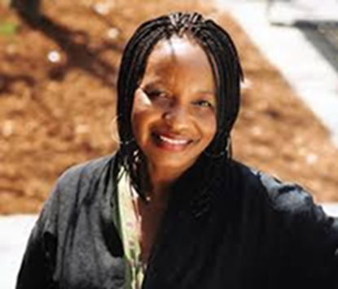
Stories about Justice & Injustice
Dominant Narratives
Counter-Narratives
Stories hidden beneath the dominant narratives that offer important truths about issues of justice and injustice, and how they have shaped our lives and society
--Dr. Theresa Perry
Resistance Narratives
Notes:
Adapted from Lee Anne Bell’s Storytelling for Social Justice
Dominant narratives are well-known, taken-for-granted stories that seek to justify the status quo, paper over the effects of injustice, or diminish the efforts of those trying to challenge injustice.
Counter narratives are the stories hidden beneath the dominant narratives that offer important truths about how issues of justice and injustice have shaped life in the United States.
Counter narratives can become resistance narratives when they inspire, motivate, and inform the efforts of future generations of citizens and activists to challenge injustice

Slide 11
Stories about Justice & Injustice
Dominant Narratives
Counter-Narratives
Resistance Narratives
What counter-narratives become when they inspire, motivate, and inform the efforts of present and future generations of citizens and activists to challenge injustice
Notes:
Adapted from Lee Anne Bell’s Storytelling for Social Justice
Dominant narratives are well-known, taken-for-granted stories that seek to justify the status quo, paper over the effects of injustice, or diminish the efforts of those trying to challenge injustice.
Counter narratives are the stories hidden beneath the dominant narratives that offer important truths about how issues of justice and injustice have shaped life in the United States.
Counter narratives can become resistance narratives when they inspire, motivate, and inform the efforts of future generations of citizens and activists to challenge injustice

Slide 12
Counter-Narratives matter when…
The dominant narrative is concealing something true and important
A group is going unrepresented or under-represented
Notes:
That second part seems really relevant for your middle schoolers who are going to be learning about the Holocaust, Slavery, and Trail of Tears

Slide 13
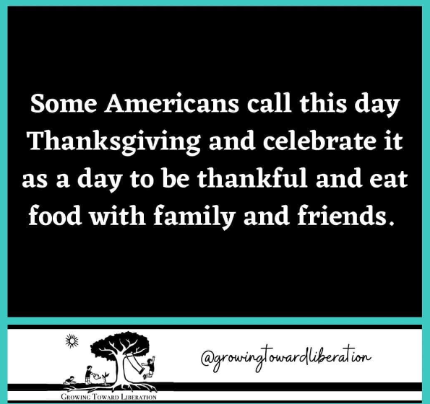
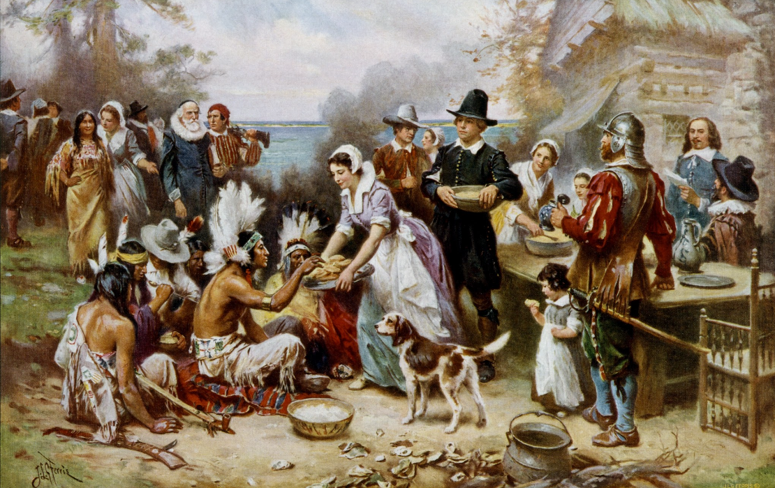
Dominant Narrative of Thanksgiving

Slide 14
Counter-Narrative of Thanksgiving

Slide 15
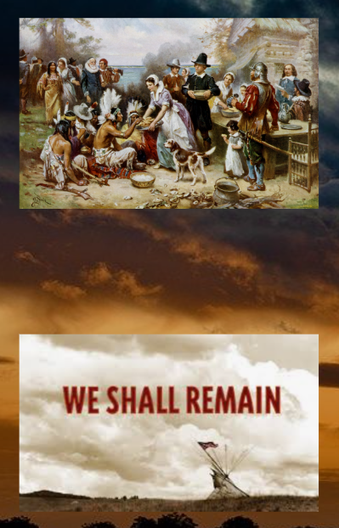
Resistance Narrative of Thanksgiving

Slide 16
Question for Discussion
Can you think of other dominant narratives you’ve learned that have counter-narratives hidden underneath them?

Slide 17
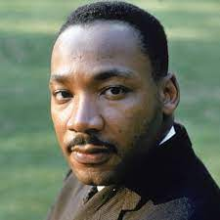
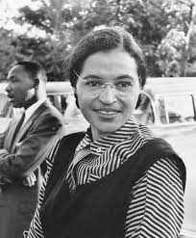
Civil Rights Movement: Dominant Narrative

Slide 18
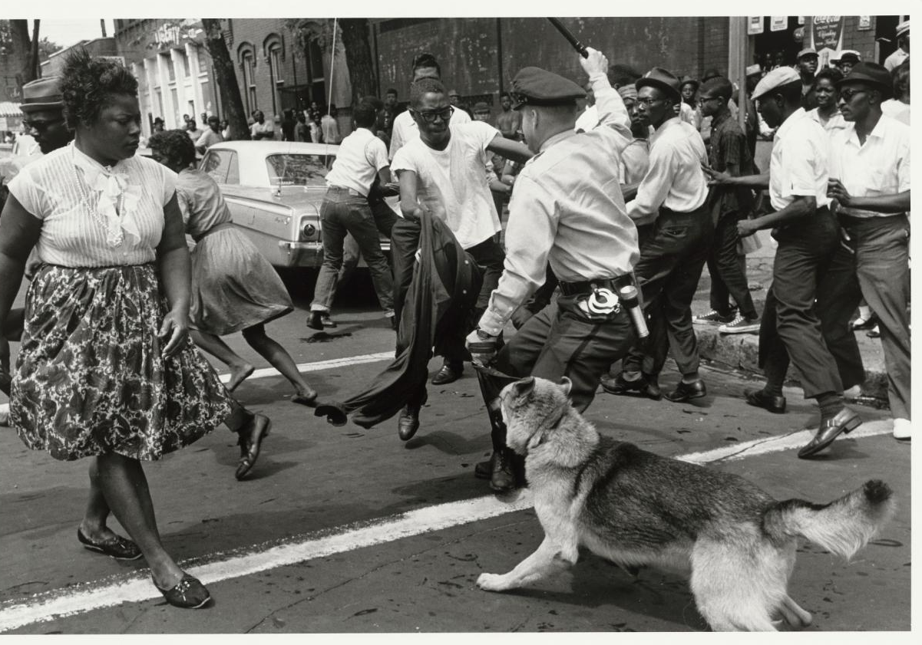
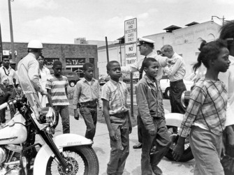
Civil Rights Movement: Counter-Narrative
Notes:
On May 2, 1963, 1000 children and teenagers skipped classes to march through downtown Birmingham, Alabama. Birmingham police commissioner Bull Connor directed police and firefirghters to attack with firehoses and dogs. Became known as Children’s Crusade. Visuals of police attacking and jailing children pushed JFK to support the Civil Rights Act of 1964,

Slide 19
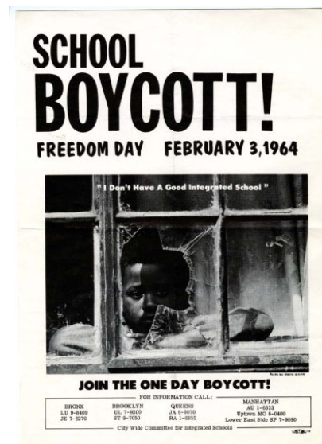
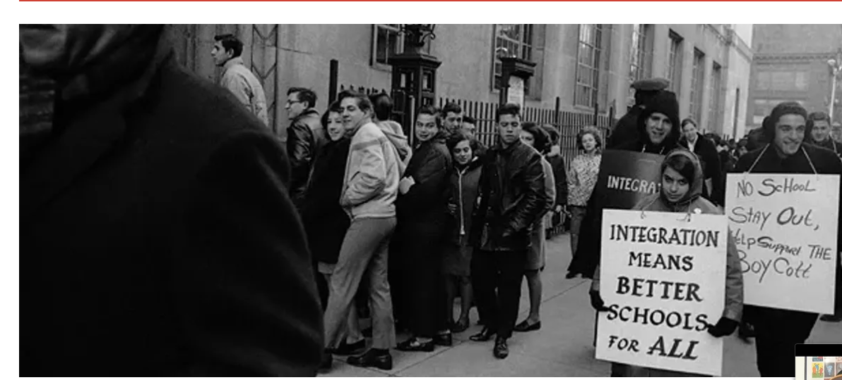
Civil Rights Movement: Counter-Narrative
Notes:
460,000 students (predominantly Black and Puerto Rican) stayed out of school to protest school segregation in NYC. Led by Bayard Rustin and Ella Baker.

Slide 20
Resistance Narrative of the Civil Rights Movement
Why do you think the history of the Civil Rights Movement is so often focused on just two individuals?
Who benefits from this dominant narrative? What is the impact of the counter-narrative not being known?
What do you think we should we do with what we know? Who is one person that might not know yet that we could share it with?

