Slide 1
Unpacking Stereotypes: The Children’s Place T-Shirt
Notes:
Greeting—Daren
Check-in– Scott
Reading– Daren
Scott– Red Cross
Daren– Corn Pops
Scott– North Georgia
Daren– learning riff debrief
Scott– overall debrief

Slide 2
Agenda
Greeting
Reading
Initiative

Slide 3
Agenda
Greeting
Reading
Initiative

Slide 4
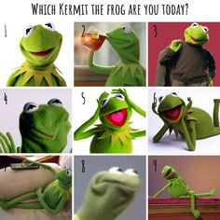

Slide 5
Agenda
Greeting and Check-in
Reading
Initiative
Debrief

Slide 6
What is a stereotype?
An unfair or untrue belief about people who belong to a particular group or share a particular characteristic

Slide 7
Reading
“No one is born believing in harmful stereotypes. They are learned over time. The good news is they can be unlearned.”
--Kevin Faulconer
What does this quotation get you thinking about?

Slide 8
Agenda
Greeting
Reading
Initiative
Debrief

Slide 9
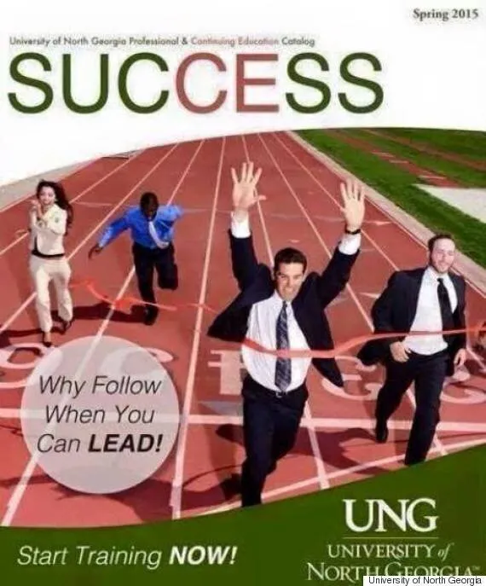
This advertisement was shared in Bell, W., & Schatz, K. (2022). Do the work: An antiracist activity handbook.
Workman Publishing.

Slide 10
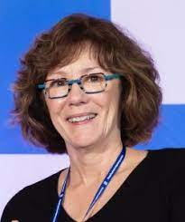
Detect, Reflect, Reject
Detect
What is the problem here?
Reflect
Why is this stereotype showing up here? Who is it harming?
Reject
What can we do to challenge this problematic stereotype?
Notes:
Patricia Devine, Psychology, Wisconsin-Madison
-Detect - understanding the problematic ideas (“What’s the pattern?)
-Reflect - take time to consider how , if at all, those are ideas are in play (what’s going on here?)
-Reject - intentionally challenging problematic ideas (“What can we do about it?”)

Slide 11
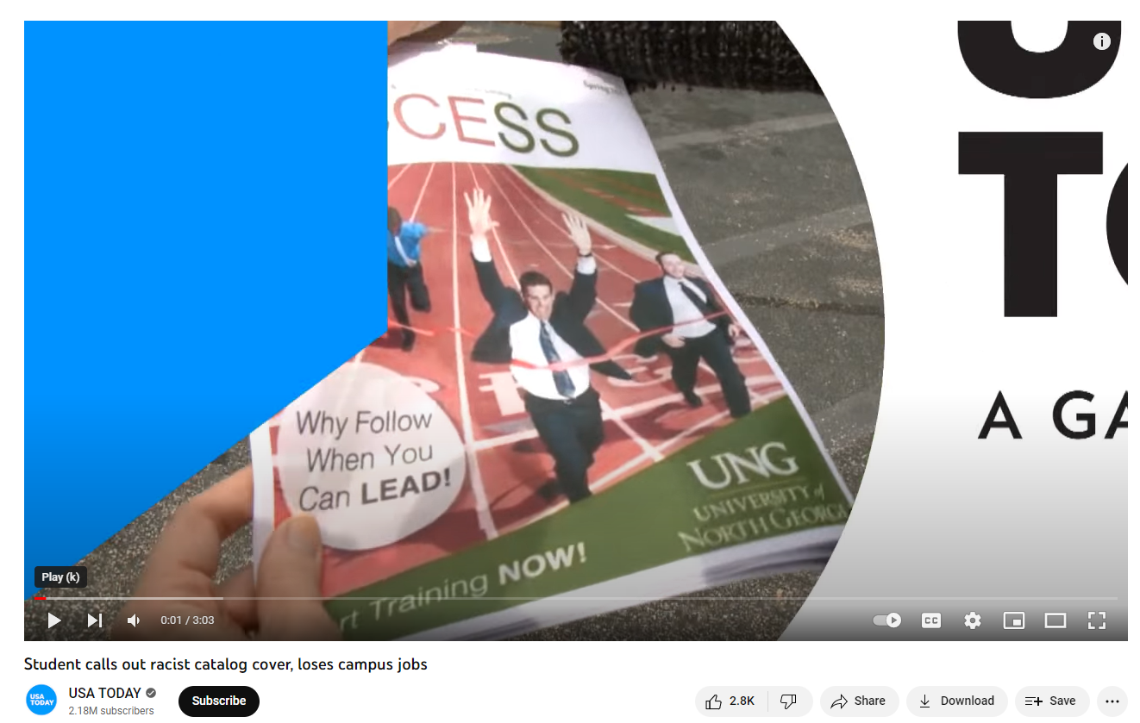
Notes:
https://www.youtube.com/watch?v=ITfn1XOwZVo

Slide 12
